Slide 2
Absence of Copyright
This slideshow contains photos, diagrams, and information, some of which were attained through internet searches of public websites. The author of this presentation does not own the copyright on this information, so this slideshow is for personal use only—not for sale or profit. Please utilize it to seek the Lord and grow in your knowledge of His Word and ways.
Bro Stan’s Revelation Study is available on our church website:
www.faithprinceton.org

Slide 4
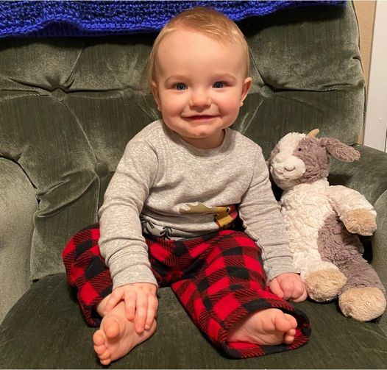
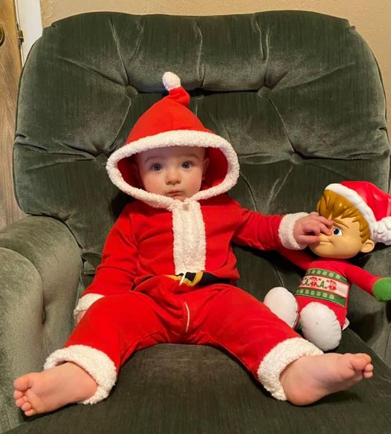
Noah’s First
Christmas

Slide 5
Prayer and Announcements
Sundays Facebook Live or In-person:
9:15 Small Group Sunday School Classes
10:30 Worship (Facebook or YouTube)
--------------------------------
Mask in and Mask out...

Slide 6
No Revelation Study next Wednesday, December 23rd
I’ll be spending time with my family...
Including my new
(yet unborn) granddaughter!

Slide 8
BEGIN HERE December 16, 2020
Week 29 – Revelation 20b
The Great White Throne Judgment

Slide 9
Revelation 20:11-15 The Great White Throne Judgment
11 Then I saw a great white throne and Him who sat upon it, from whose presence earth and heaven fled, and no place was found for them. 12 And I saw the dead, the great and the small, standing before the throne, and books were opened; and another book was opened, which is the book of life; and the dead were judged from the things which were written in the books, according to their deeds.
Notes:
Vs 11 earth and heaven fled
2 Peter 3
New International Version
The Day of the Lord
1 Dear friends, this is now my second letter to you. I have written both of them as reminders to stimulate you to wholesome thinking. ² I want you to recall the words spoken in the past by the holy prophets and the command given by our Lord and Savior through your apostles.
³ Above all, you must understand that in the last days scoffers will come, scoffing and following their own evil desires. ⁴ They will say, “Where is this ‘coming’ he promised? Ever since our ancestors died, everything goes on as it has since the beginning of creation.” ⁵ But they deliberately forget that long ago by God’s word the heavens came into being and the earth was formed out of water and by water. ⁶ By these waters also the world of that time was deluged and destroyed. ⁷ By the same word the present heavens and earth are reserved for fire, being kept for the day of judgment and destruction of the ungodly.
⁸ But do not forget this one thing, dear friends: With the Lord a day is like a thousand years, and a thousand years are like a day. ⁹ The Lord is not slow in keeping his promise, as some understand slowness. Instead he is patient with you, not wanting anyone to perish, but everyone to come to repentance.
¹⁰ But the day of the Lord will come like a thief. The heavens will disappear with a roar; the elements will be destroyed by fire, and the earth and everything done in it will be laid bare.
¹¹ Since everything will be destroyed in this way, what kind of people ought you to be? You ought to live holy and godly lives ¹² as you look forward to the day of God and speed its coming. That day will bring about the destruction of the heavens by fire, and the elements will melt in the heat. ¹³ But in keeping with his promise we are looking forward to a new heaven and a new earth, where righteousness dwells.
¹⁴ So then, dear friends, since you are looking forward to this, make every effort to be found spotless, blameless and at peace with him. ¹⁵ Bear in mind that our Lord’s patience means salvation, just as our dear brother Paul also wrote you with the wisdom that God gave him. ¹⁶ He writes the same way in all his letters, speaking in them of these matters. His letters contain some things that are hard to understand, which ignorant and unstable people distort, as they do the other Scriptures, to their own destruction.
¹⁷ Therefore, dear friends, since you have been forewarned, be on your guard so that you may not be carried away by the error of the lawless and fall from your secure position. ¹⁸ But grow in the grace and knowledge of our Lord and Savior Jesus Christ. To him be glory both now and forever! Amen.

Slide 10
Revelation 20:11-15 The Great White Throne Judgment
11 Then I saw a great white throne and Him who sat upon it, from whose presence earth and heaven fled, and no place was found for them. 12 And I saw the dead, the great and the small, standing before the throne, and books were opened; and another book was opened, which is the book of life; and the dead were judged from the things which were written in the books, according to their deeds.
Notes:
Great White Throne Judgment
All people?
Book of Life trumps what is written in the books of deeds
Newport (303) “It means that the great white throne judgment is not arbitrary but based upon the evidence written by the life of every person.” ... Dante’s Divis not a Divine Comedy pictures men attached to whatever they gave their lives to... “Works are unmistakable evidence of the loyalty of the heart. They express either belief or unbelief, faithfulness or unfaithfulness. The judgment will reveal through the records whether the loyalties were with God and the Lamb or with God’s enemies.... This judgment is not a ‘balancing of the books,’ a weighing of good works and bad works....”
Just the unbelievers?
??? Separate BEMA SEAT ?? (Christians have a judgment of works at the judgment seat [bema] of Christ 2 Corinthians 5:10: For we must all appear before the judgment seat of Christ, so that each one may receive what is due for what he has done in the body, whether good or evil.)
https://www.gotquestions.org/great-white-throne-judgment.html
Some Christians believe that the Scriptures reveal three different judgments to come. The first is the judgment of the sheep and the goats or a judgment of the nations (Matthew 25:31-36). This takes place after the tribulation period but prior to the millennium; its purpose is to determine who will enter the millennial kingdom. The second is a judgment of believers’ works, often referred to as the “judgment seat [bema] of Christ” (2 Corinthians 5:10). At this judgment, Christians will receive degrees of reward for their works or service to God. The third is the great white throne judgment at the end of the millennium (Revelation 20:11-15). This is the judgment of unbelievers in which they are judged according to their works and sentenced to everlasting punishment in the lake of fire. Other Christians believe that all three of these judgments speak of the same final judgment, not of three separate judgments. In other words, the great white throne judgment in Revelation 20:11-15 will be the time that believers and unbelievers alike are judged. Those whose names are found in the book of life will be judged for their deeds in order to determine the rewards they will receive or lose. Those whose names are not in the book of life will be judged according to their deeds to determine the degree of punishment they will receive in the lake of fire. Those who hold this view believe that Matthew 25:31-46 is another description of what takes place at the great white throne judgment. They point to the fact that the result of this judgment is the same as what is seen after the great white throne judgment in Revelation 20:11-15. The sheep (believers) enter into eternal life, while the goats (unbelievers) are cast into “eternal punishment” (Matthew 25:46). Whichever view one holds of the great white throne judgment, it is important to never lose sight of the facts concerning the coming judgment(s). First, Jesus Christ will be the judge, all unbelievers will be judged by Christ, and they will be punished according to the works they have done. The Bible is very clear that unbelievers are storing up wrath against themselves (Romans 2:5) and that God will “give to each person according to what he has done” (Romans 2:6). Believers will also be judged by Christ, but since Christ’s righteousness has been imputed to us and our names are written in the book of life, we will be rewarded, but not punished, according to our deeds. Romans 14:10-12 says that we will all stand before the judgment seat of Christ and that each one of us will give an account to God.

Slide 11
Revelation 20:11-15 The Great White Throne Judgment
13 And the sea gave up the dead who were in it, and Death and Hades gave up the dead who were in them; and they were judged, each one of them according to their deeds. 14 Then Death and Hades were thrown into the lake of fire. This is the second death, the lake of fire. 15 And if anyone’s name was not found written in the book of life, he was thrown into the lake of fire.
Notes:
God will cast Satan, the deceiver, into "the lake of fire" that He previously prepared for the devil and his angels (Matt. 25:41).
Death and Hades ➔ final enemies of mankind (1 Corinthians 15 “death is swallowed up in victory!”)
NO MORE DEATH !!!!
ETERNAL LIFE !!!
But only for those whose names are found written in the book of life ! (Lamb’s Book of Life, OT: book of the living)
Newport (303) “When taken seriously, this final note evaporates all theories of universalism.”
John’s Message of the Gospel of Jesus Christ = HE is the ONLY WAY:
John 11:25 (ESV) 25 Jesus said to her, “I am the resurrection and the life. Whoever believes in me, though he die, yet shall he live,
John 14:6, “I am the way, the truth, and the life. No one comes to the Father except through me.”
John 17:3 (ESV) 3 And this is eternal life, that they know you, the only true God, and Jesus Christ whom you have sent.
1 John 2:2 (ESV) 2 He is the propitiation for our sins, and not for ours only but also for the sins of the whole world.
1 John 2:12 (ESV)12 I am writing to you, little children, because your sins are forgiven for his name’s sake.
1 John 4:1-3 Beloved, do not believe every spirit, but test the spirits to see whether they are from God, because many false prophets have gone out into the world. 2 By this you know the Spirit of God: every spirit that confesses that Jesus Christ has come in the flesh is from God; 3 and every spirit that does not confess Jesus is not from God; this is the spirit of the antichrist, which you have heard is coming, and now it is already in the world.
1 John 5:11-13 11 And the testimony is this, that God has given us eternal life, and this life is in His Son. 12 The one who has the Son has the life; the one who does not have the Son of God does not have the life. 13 These things I have written to you who believe in the name of the Son of God, so that you may know that you have eternal life.
MOST FAMOUS PASSAGE
John 3:13-2113 No one has ascended into heaven except he who descended from heaven, the Son of Man.7 14 And as Moses lifted up the serpent in the wilderness, so must the Son of Man be lifted up, 15 that whoever believes in him may have eternal life.
For God So Loved the World
16 “For God so loved the world,9 that he gave his only Son, that whoever believes in him should not perish but have eternal life. 17 For God did not send his Son into the world to condemn the world, but in order that the world might be saved through him. 18 Whoever believes in him is not condemned, but whoever does not believe is condemned already, because he has not believed in the name of the only Son of God. 19 And this is the judgment: the light has come into the world, and people loved the darkness rather than the light because their works were evil. 20 For everyone who does wicked things hates the light and does not come to the light, lest his works should be exposed. 21 But whoever does what is true comes to the light, so that it may be clearly seen that his works have been carried out in God.”

Slide 12
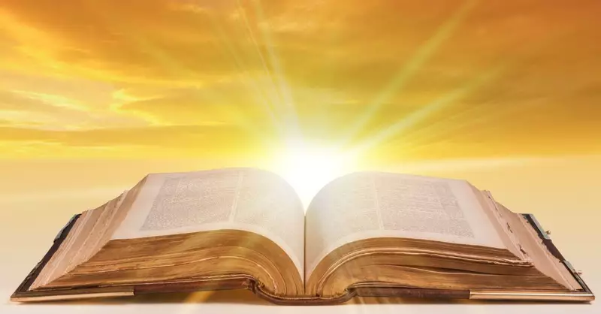
Is your name written in the Lamb’s Book of Life?
Notes:
The Lamb’s Book of Life
Luke 10:20 ESV
Nevertheless, do not rejoice in this, that the spirits are subject to you, but rejoice that your names are written in heaven.”
Revelation 13:8 ESV
And all who dwell on earth will worship it, everyone whose name has not been written before the foundation of the world in the book of life of the Lamb who was slain.
Revelation 21:27 ESV
But nothing unclean will ever enter it, nor anyone who does what is detestable or false, but only those who are written in the Lamb's book of life.
IS YOUR NAME WRITTEN IN THE LAMB’S BOOK OF LIFE: CALL OUT TO JESUS NOW... ASK HIS FORGIVENESS AND CLEANSING... ACCEPT HIS LORDSHIP AND MERCY... BE SET FREE FROM YOUR SLAVERY TO SATAN, SELF, AND SIN... YIELD YOUR HEART TO THE FATHER...

Slide 13
Revelation 21:1-4 The Presence of God
1 Then I saw a new heaven and a new earth; for the first heaven and the first earth passed away, and there is no longer any sea. 2 And I saw the holy city, new Jerusalem, coming down out of heaven from God, prepared as a bride adorned for her husband.
Notes:
New Jerusalem ➔ contrasted with Babylon, the great whore !!
No longer any sea == the sea was a symbol of separation and danger ! ALSO. No need for sea commerce... Sustainable through tree of life and fresh water coming from the throne and light from the Lord and the Lamb (Revelation 22:1-2) !

Slide 14
Revelation 21:1-4 The Presence of God
3 And I heard a loud voice from the throne, saying, “Behold, the tabernacle of God is among the people, and He will dwell among them, and they shall be His people, and God Himself will be among them, 4 and He will wipe away every tear from their eyes; and there will no longer be any death; there will no longer be any mourning, or crying, or pain; the first things have passed away.”
Notes:
ADVENT MESSAGE: threefold COMING of Christ:
Jesus came and dwelt among us ➔ Immanuel == God with us
PURPOSE: TO SAVE SINNERS
Jesus came through indwelling Holy Spirit ➔ God in us (Colossians 1 Christ in you, the hope of glory == mystery)
PURPOSE: TO SANCTIFY SAINTS AND CONVICT OF SIN, RIGHTEOUSNESS AND JUDGMENT
Jesus will come again to take us to Himself (John 14: where I am, you will be also) ➔ Us with God == He will dwell among us and be our tabernacle (dwelling place)
PURPOSE: TO SETTLE US IN HIS PRESENCE == IN HIS HOUSEHOLD
God Himself will be among them, 4 and
He will wipe away every tear from their eyes; == NO TEARS IN HEAVEN OR JUST COMFORTED IMMEDIATELY WHEN THEY FALL???
and there will no longer be
any death;
any mourning, or
crying, or
pain;
the first things have passed away.” (FIRST THINGS ➔ TEMPORARY) ... Again, “so be brave in face of persecution”

